Slide 1

Project Progress
Team Presentation – Week 7
Practical and Social Challenges for International Students at University of Melbourne
Group E
INFO90010 – Technology Innovation Project

Slide 2

Introduction
Investigation Topic
Investigating the practical and social challenges for International Students at the University of Melbourne
What is the problem?
The identified challenges based on recent studies existing innovations
Initial Expectations?
What we discovered
Cultural adaptation difficulties
Language barriers
Overlooked financial struggles, but many faced them. These challenges are not isolated, they're part of a wider web of interconnected issues
1
Lack of social and cultural integration was the primary challenge
Academic pressure
Social isolation
These interconnected struggles all hinder the students to thrive academically and personally
A smart AI-powered one-stop platform could solve it
A tech-only solution is not enough. A real support needs to include human empathy, tailored services
2
Why is it important?
The need to address these challenges reinforced by the growing number of international students, projected to reach 8 mil by 2025 (Wang et al., 2023)
3
Students just need better access to info and events
Many are isolated, overwhelmed and don’t know when or how to ask for help
Students struggle academically
Withdraw socially
Key Insights
Face prolonged adaptation difficulties
Enrich academic and social life in Australia
Our innovation journey started with a narrow scope but has expanded into a deeper understanding of students’ complex realities. This shift is now structing the direction of our innovative solution
Bureaucratic hurdles, adjustment difficulties and lack of awareness further complicate the ability for international students to seek help
Social innovation must reflect these overlapping challenges and not just addressing one dimension of the international student’s journey
Notes:
We chose this topic because, like many, we were once international students trying to adjust to life in Australia such as learning new norms, navigating a new culture, and finding our place. While we were fortunate to eventually settle in, we couldn’t ignore how challenging that journey was and how many others continue to face similar, if not greater, struggles.
In our preliminary research, we found that international students across Australia often face a complex mix of cultural adjustment issues, social isolation, and academic pressure. Initially, we believed the main barrier was simply adapting to the local culture. But as we dove deeper into our qualitative research, we uncovered something much more interconnected, financial hardship emerged as a major factor that often-amplified other challenges.
We started this project thinking a single, centralized solution might help. but what we heard from participants changed everything. They wanted something more human, more personalized, better transparency, and could guide them through the overwhelming number of university resources while still acknowledging their unique circumstances.
That discovery shifted our focus entirely. And that’s how we arrived here in week 7. Excited to share the evolution of our journey and the insights we've gathered along the way.

Slide 3






Investigation Method: Exploring the Experiences of the Students
Secondary Research – Research & Literature Reviews
Primary Research - Interviews
1
Review of Academic Studies and Journals
3
1
Interviews with UniMelb’s Students
Inductive Thematic Analysis
Systematically analyze themes from raw data via bottom-up approach
Focus on international students’ cross-cultural adaptation, well-being and university’s support systems
Conducted 8 semi-structured interviews
Focus on cultural and practical challenges, campus integration and support systems
The team brainstorm to refine and validate the themes
Week 3-7
2
Purpose of Literature Review
Week 2 and continuous
Affinity Diagrams
To triangulate and validate findings from the interviews
2
4
Limitations
Grouped similar sentiments and coded the interview responses
Small sample size might not fully reflect broader experience
To make sure the thematic analysis was consistent with the real-world challenges
Highlighted interviewees pain points and social adjustment themes
To assist filling in gaps that were not captured by the interview data
Key Takeaways
By combining these two investigation approaches, the analysis able to capture direct student voices together with academic insights. This ensures that the findings are both grounded in lived experiences and confirmed by broader research.
Notes:
To effectively capture the student experience, we employed a dual-method research approach. Our primary research involved eight semi-structured interviews with University of Melbourne students, targeting cultural integration, practical challenges, and support systems. We synthesized these findings using affinity diagrams and inductive thematic analysis, enabling us to identify key pain points and validate our themes thoroughly.
Despite a limited sample size, which we acknowledge as a limitation, the richness of direct student insights was invaluable. To complement our primary research, we conducted a comprehensive literature review focusing on international student adaptation, well-being, and institutional support systems. This secondary research validated our findings, ensuring alignment with broader academic research and filling any gaps left by interview data alone.

Slide 4
Key findings: Interview Data Analysis
Themes
Initial Requirements
Accommodation issues
Unexpected expenses for house inspections
Cultural and religious concerns for housing
Unfamiliar with surrounding areas, housing schemes
1
The need of transparent information on house seeking
Key Insight: Academic Studies
Two peer-reviewed professional papers published in JANZSSA (Journal of the Australian and New Zealand Student Services Association):
The main challenges faced by international students — from both professional staff and student perspectives are social wellbeing, academic adjustment, financial stress, and housing (Newton et al., 2021).
Another recent study on international students in Melbourne also shows that housing affordability has become a serious issue to them (Hassan et al., 2023).
Academic integration
Course structured and delivered differently
Difficult to adjust to a new education system
Improve exposure to the university for academic adjustment
2
Social and culture adaptation
Learning and adapting to accents/slangs/idioms is exhausting
Hard to join activities involving clubbing & alcoholic culture
Lack of college culture discourages participation
3
Increase and encourage social engagement
Finding communities with shared interest
Finding interest-based communities can be frustrating at times
Clubs are inactive due to low number of activities
Highlights/Remarkable Quotes
4
"I wish I knew that it is difficult to find accommodation in here.“
“I think a lot of students face problem with finding a right place to stay.”
“American universities have different course structures… here in Australia it’s completely different... now I must get used to it again.”
“If I were to reflect on the main issue that students face um would be not having a friend when they first arrive in Melbourne”
Technological Usability
Poor internal system e.g. crashes on scheduling site
Having a live caption tool can be beneficial
5
Implement desirable technological features
Financial Stress
Had to find part-time jobs to support daily expenses
A higher cost of living causes stress in budgeting
6
The need of financial tips and recommendations
Notes:
The first theme we identified is the housing issue, our interviewees addressed that finding a suitable place to stay is difficult especially during the early semesters.
The second one would be academic integration. Our interviewees found it difficult to adjust to new course structures and education systems when they first arrived.
The third theme we identified is social and culture adaptation. Based on our interviews, many students said that learning accents, slang and idioms is quite tiring, and also mentioned sometimes it’s hard to join events that involve certain cultures because of religion or personal preferences.
The fourth one is finding communities with shared interest. Our interviewees spoke about the frustration of finding interest-based communities.
The fifth one is technological usability that is specifically about unimelb. The quality of the internal system is quite poor at times, they also mentioned that they would like to see more helpful features being implemented.
And the last one is financial stress. From our interviews, we learned that many of the international students need to find part-time jobs to support their daily expenses.
As Q mentioned before, we also did some academic studies on the challenges to back our interview data, validate our findings, and make up our small sample size. The studies are highly relatable to our investigation and the results are also identical to what we learned from our interviews.
We also included some highlights from our interviews that we think captures the students challenges very well
So, moving forward from our findings and themes, we have identified 5 initial requirements to help us construct personas so that we can see how these challenges affected the students from the intended user’s perspective. And I’ll leave that to Daniel.

Slide 5
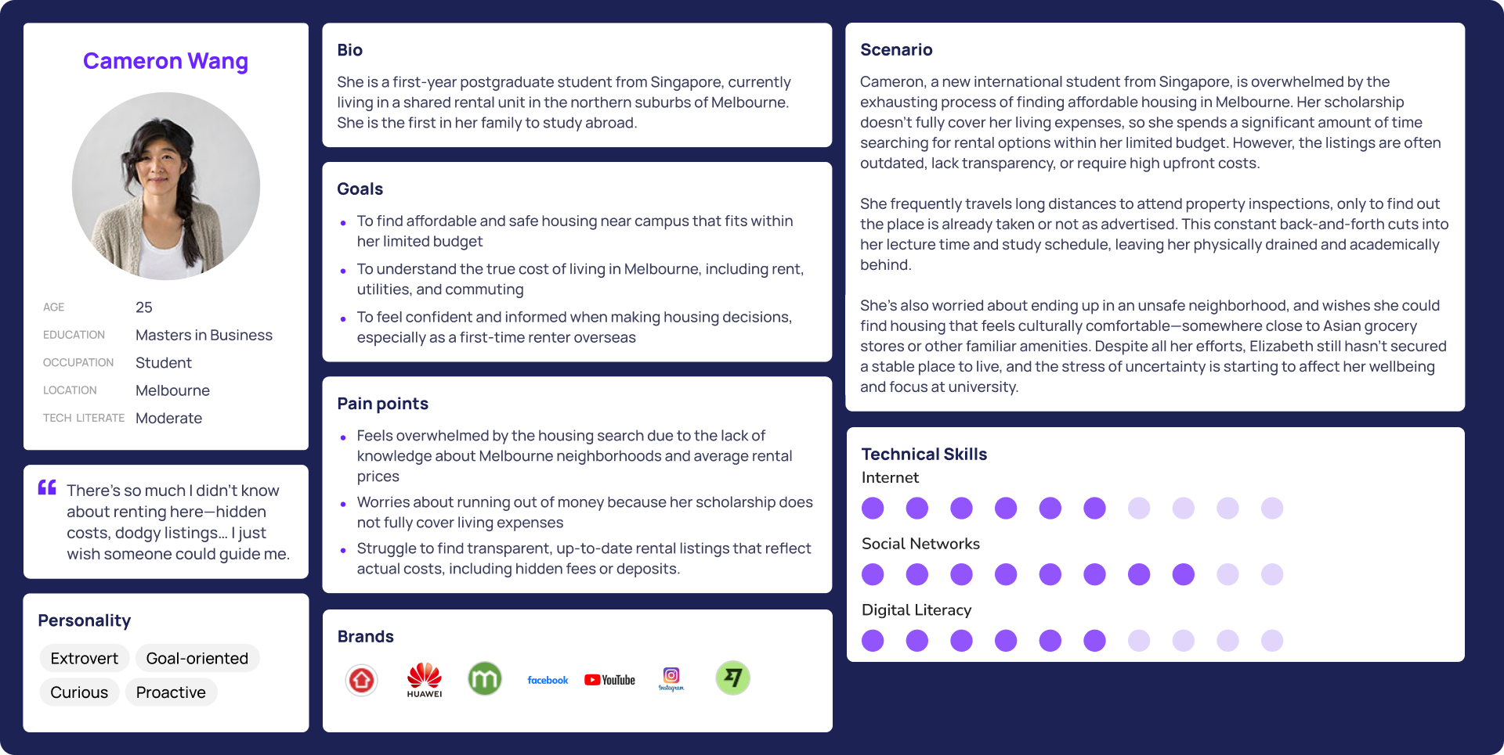
Notes:
Let's start with Cameron Wang, a 25-year-old postgraduate student from Singapore pursuing a Master’s in Business. She’s the first in her family to study abroad and lives in a shared rental unit in Melbourne’s northern suburbs. Cameron is overwhelmed by the housing search. Her scholarship doesn’t fully cover expenses, so she spends significant time searching for affordable options. However, outdated listings and hidden costs waste her time and energy. Long commutes for inspections cut into her study schedule, leaving her drained. Her goals include finding affordable housing near campus, understanding Melbourne’s cost of living, and feeling confident as a first-time renter overseas. Cameron’s pain points include a lack of knowledge about neighborhoods, worries about hidden fees, and difficulty finding transparent rental information.

Slide 6
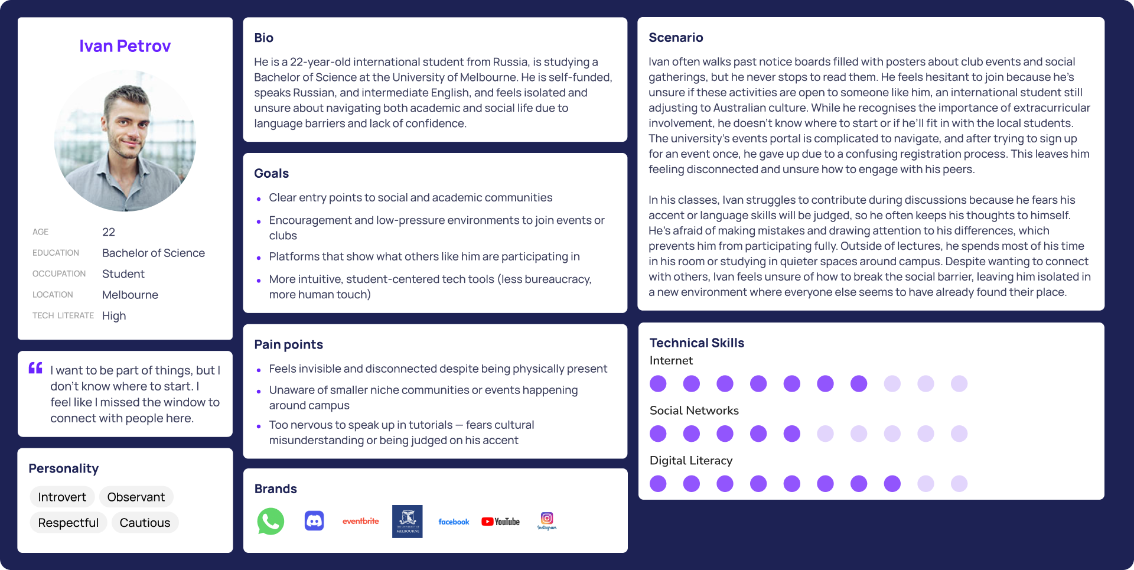
Notes:
Now, let’s look at Ivan Petrov, a 22-year-old international student from Russia studying a Bachelor of Science. Ivan is self-funded, speaks Russian, and has intermediate English skills. He struggles with isolation and navigating academic and social life due to language barriers and a lack of confidence. He often notices posters about campus events but hesitates to engage, unsure if they’re open to international students. A confusing registration process discouraged him from joining activities, leaving him disconnected. In class, he avoids discussions out of fear of judgment on his accent or language skills. Ivan’s goals are to find clear entry points to social and academic communities, participate in low-pressure environments, and use more intuitive tech tools that reduce bureaucracy. His pain points include feeling invisible, being unaware of niche events on campus, and feeling too nervous to contribute in tutorials.

Slide 7


Future Planning - Requirements
Persona | Pain Point | Proposed Feature
 | Difficulty finding affordable and conveniently located housing. Constant back-and-forth to physical inspections, affecting study and lecture attendance. Lack of time and energy to manually compare listings. | Smart Housing Recommendation System Matches students to rental listings based on their budget, preferred distance from campus, deposit limits, and lease duration to streamline the housing search and reduce stress from repeated inspections.
 | Lack of transparent rental pricing and hidden costs. Concerns about neighborhood safety. Difficulty understanding true cost of living (commute, amenities). | Visual Housing Insights Provides an easy-to-understand visual overview of housing data including price trends, commute costs, neighborhood safety, cultural fit, and peer reviews to help students make informed rental decisions confidently.
 | Low Engagement in University Activities Uncertainty about Where to Start Fear of Social Isolation Lack of Academic and Cultural Integration | EngageU: Social & Academic Integration Game Motivates students to engage with campus life through fun, low-pressure quizzes and activity challenges that reward participation, increase cultural familiarity, and foster a stronger sense of community.
Notes:
This slide shows how we translated each persona’s key struggles into targeted features. For Cameron, we grouped her housing-related challenges like affordability, time-consuming searches, and unclear neighborhood safety into two tools: a smart recommendation system that matches her preferences and budget, and a smart visual interface that maps out rental options using heatmaps, commute data, and cultural fit. For Ivan, we focused on his sense of academic and social disconnection. To address this, we propose ‘EngageU’, a reward-based system using quizzes and event participation to help him build confidence, understand the university environment, and connect with peers. Each feature is purpose-built to address a distinct set of pain points uncovered during our investigation.

Slide 8
Future Planning - KPI to Evaluate Design Ideas
Technical
Product Performance
User Engagement & Growth
How is the design ideas performing from an adoption and systems view?
Are the users actively engaging and growing in the ecosystem?
App downloads and install rate
Number of users installed the app
Participation rate in classes
Metric to be measured by UniMelb
User retention rate
(7-day/30-day) % of users returning
Event participation tracking
Number of international students attending culture-linked programs
Feature usage analytics
Frequency of QR scans, feedback submitted
Sharing Rate
% of users invited friends
Bug resolution & report time
Average time to fix technical issues
EngageU participations
Number of games completed
User Experience & Sentiment
Strategic Outcomes
Are we meaningfully improving lives?
Is the solution transforming broader institutional value?
Net promoter score (NPS)
“How likely to recommend the app to a colleague”
Student integration index
Self-reported composite metric from events, social ties and students’ confidence level
Helpfulness rating of feedback
Metrics in app that measure connectedness and comfort level
Feedback closure rate
% of feedback turned into visible university actions
Non-Technical
Our KPI balance the innovation success with meaningful social outcomes, making sure the solution not only technically feasible but drives real change in the international students’ university experience
Notes:
Moving forward, it’s essential we have clear KPIs to measure our solution's effectiveness comprehensively. We've categorized these into technical and non-technical dimensions. Technically, we'll monitor product performance, including app download rates, user retention, feature usage analytics, and technical issue resolution efficiency. For user engagement and growth, participation in classes, event tracking, and social sharing rates will be critical indicators. User experience and sentiment will be measured through Net Promoter Scores, helpfulness ratings, and cultural belonging feedback. Strategically, we'll track the student integration index and feedback closure rate, linking directly to broader institutional value.
Ultimately, our KPIs are designed not just to confirm technical feasibility but to ensure our innovation delivers tangible, meaningful improvements to the international student university experience.
Technical tells you what's happening in the app
Non-technical tells you what’s happening in the students’ lives as a result

Slide 9
Risk Analysis
Risk Statement | Empathy Gap: The solution may not be empathetic or culturally responsive enough to truly connect with international students.
Risk Impact | Without meaningful and contextual engagement, there is a possibility that the solution may be perceived as generic or irrelevant, leading to low user adoption and, eventually, project dormancy.
Management Process | Consultation with subject matter experts (SMEs) in international education, cultural integration, etc. Their expertise helps ensure our solution remains relevant and grounded in real needs. Collaborative brainstorming sessions among team members to bring in a wide range of perspectives in our planning.
Mitigation | Revising core features to prioritize more urgent needs that were discovered during the analysis of the investigation data.
By staying responsive and flexible, we aim to ensure the project remains aligned with its purpose: creating a meaningful, supportive tool that addresses the challenges faced by international students.
Key Takeaways
Notes:
As for our risk analysis for this project, the most significant risk that we identified is the empathy gap: There is a risk that the solution may not be empathetic enough to truly connect with international students. This is highly impactful because if our solution doesn’t contain any meaningful and contextual engagement, our solution might become dormant due to low usage. To manage this situation, we would actively consult with subject matter experts to help us improve our solution, we would also have brainstorming sessions among ourselves to bring in more perspective. To mitigate the risk, we would revise our core features ensuring that our solution can prioritize more urgent needs that are discovered in our findings.

Slide 10
References
Newton, D. C., Tomyn, A. J., & LaMontagne, A. D. (2021). Exploring the challenges and opportunities for improving the health and wellbeing of international students: Perspectives of international students. JANZSSA: Journal of the Australian and New Zealand Student Services Association, 29(1), 18–34. https://search.informit.org/doi/10.3316/informit.352915754847750
Newton, D. C., Tomyn, A. J., & LaMontagne, A. D. (2021). Exploring the challenges and opportunities for improving the health and wellbeing of international students: Perspectives of professional staff at an Australian University. JANZSSA: Journal of the Australian and New Zealand Student Services Association, 29(1), 74–92. https://search.informit.org/doi/10.3316/informit.352971653761524
Hassan, S., Chuen Poon, W., & Alisa, I. (2023). Australian housing market: a descriptive study on key issues around housing affordability relevance to international university students in Melbourne, Australia. E3S Web of Conferences, 389, 09029. https://doi.org/10.1051/e3sconf/202338909029
‌

